Slide 1
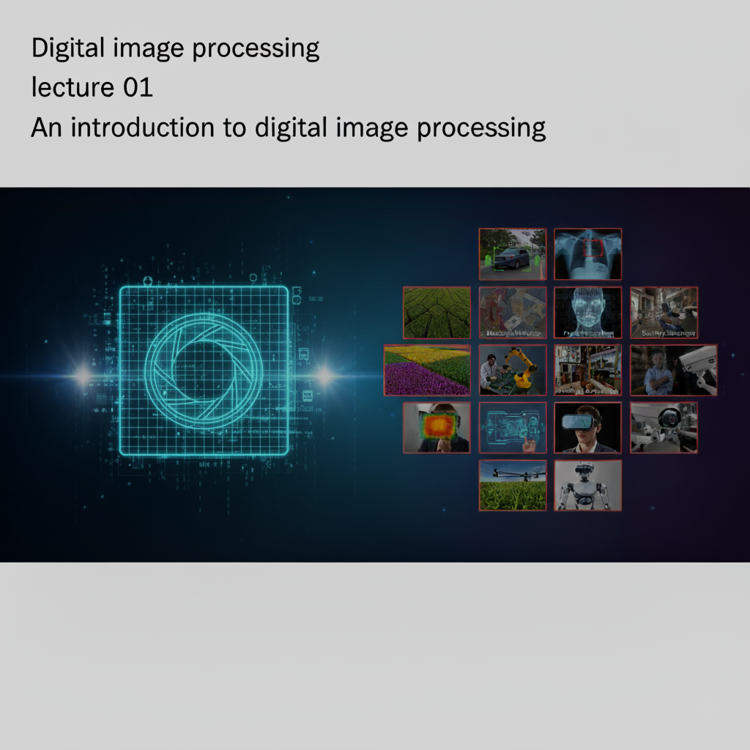
Morphological Image Processing
Digital Image Processing
Lecture 05
Dr. Muhammad Sajjad
R.A: Asad Ullah

Slide 2








7
Closing
Overview
6
Opening
1
Introduction
5
Dilation
2
Structuring Elements
4
Erosion
3
Fundamental Operations

Slide 3
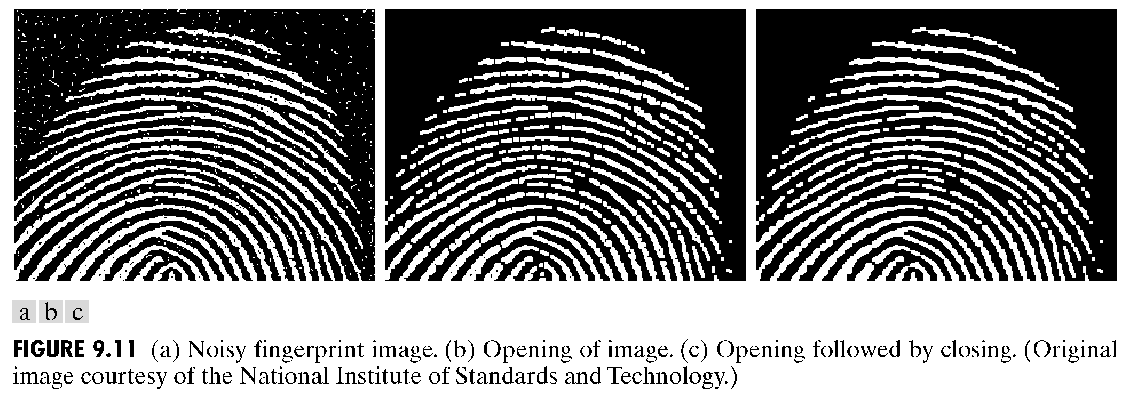
Introduction
Morphological image processing describes a range of image processing techniques that deal with the shape (or morphology) of features in an image.
Morphological image processing is used to extract image components for representation and description of region shape, such as boundaries, skeletons, and the convex hull
Morphological operations are typically applied to remove imperfections introduced during segmentation, and so typically operate on bi-level images
Image after segmentation
Image after segmentation and morphological processing

Slide 4
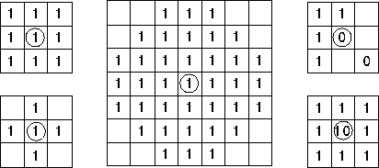
Structuring Elements
Structuring elements are small binary images used as shape masks in basic morphological operations.
They can be any shape and size that is digitally representable.
However, for simplicity we will use rectangular structuring elements with their origin at the middle pixel
Usually, element values are 0 or 1, but other values are possible (including none!)
Empty spots in the Structuring Elements are don’t cares!
Box
Disc

Slide 5
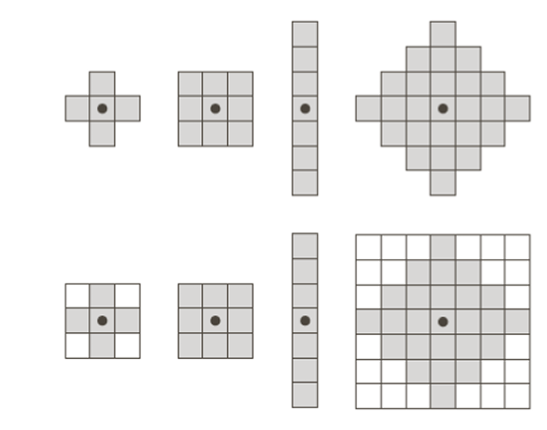
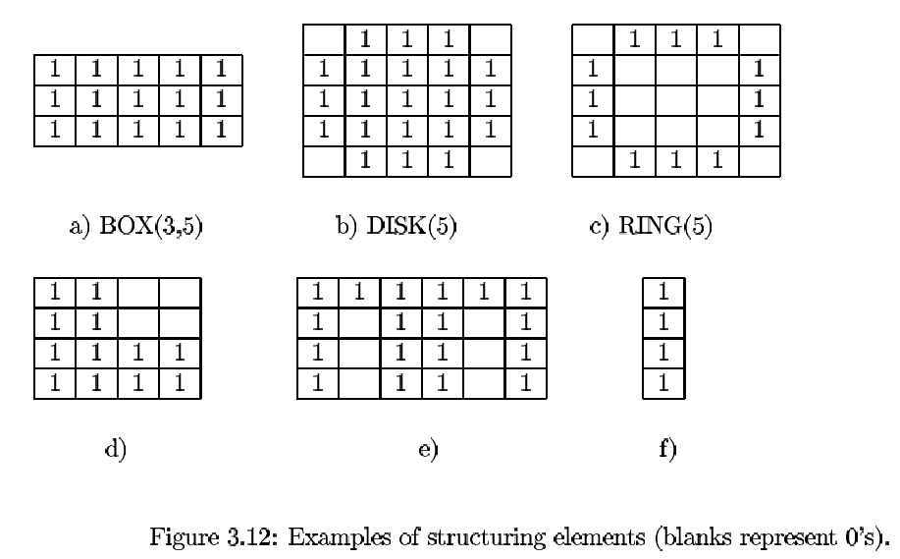
Structuring Elements Examples
box
hexagon
disk
something
box(length,width) disk(diameter)
origin

Slide 6



Fundamental Operations
SE
Fundamentally morphological image processing is very like spatial filtering
The structuring element is moved across every pixel in the original image to give a pixel in a new processed image
The value of this new pixel depends on the operation performed
There are two basic morphological operations: erosion and dilation
Input
Dilation
Output
Input
Erosion
Output

Slide 7
Erosion (based on “Fit”)
Erosion of image f by structuring element s is given by f  s
The structuring element s is positioned with its origin at (x, y) and the new pixel value is determined using the rule:

Slide 8
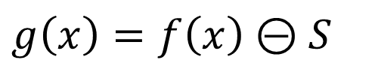
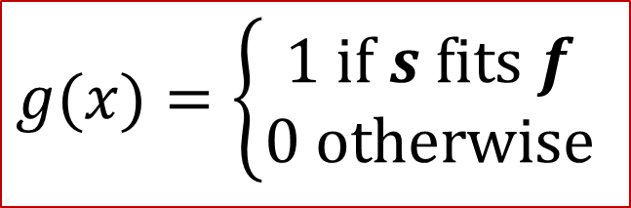
1D Erosion (based on “Fit”)
Input image
1 | 0 | 0 | 0 | 1 | 1 | 1 | 0 | 1 | 1
1
1
1
Structuring Element
Output Image
0
0
0
0
1
0
0
0
$$g(x)=\left\{\begin{matrix}\text{1 }\text{if} s \text{fits} f \\ \text{0 }\text{otherwise}\end{matrix}\right.$$
$$g\left(x\right)=f\left(x\right)⊝S$$

Slide 9
2D Erosion (based on Fit)
Original Image
Processed Image With Eroded Pixels
Don’t care values
Assume zero padding have been done
Structuring Element
1’s values

Slide 10
2D Erosion (based on Fit)
Original Image
Processed Image
Pixels have been discarded in output which didn’t fit
Pixels have been remained in output which fit
Overall Object get smaller
Structuring Element

Slide 11
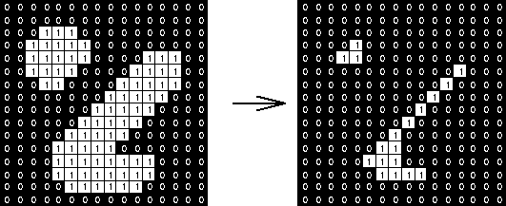
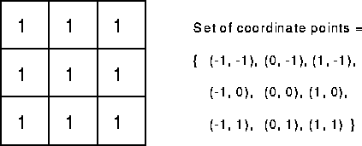
2D Erosion (based on Fit)
_
Structuring element
Objects get smaller

Slide 12

Erosion Example 1
Original image
Erosion by 3*3 square structuring element
Erosion by 5*5 square structuring element
Watch out: In these examples a 1 refers to a black pixel!

Slide 13

Erosion Example 2
Original image
After erosion with a disc of radius 10
After erosion with a disc of radius 5
After erosion with a disc of radius 20

Slide 14
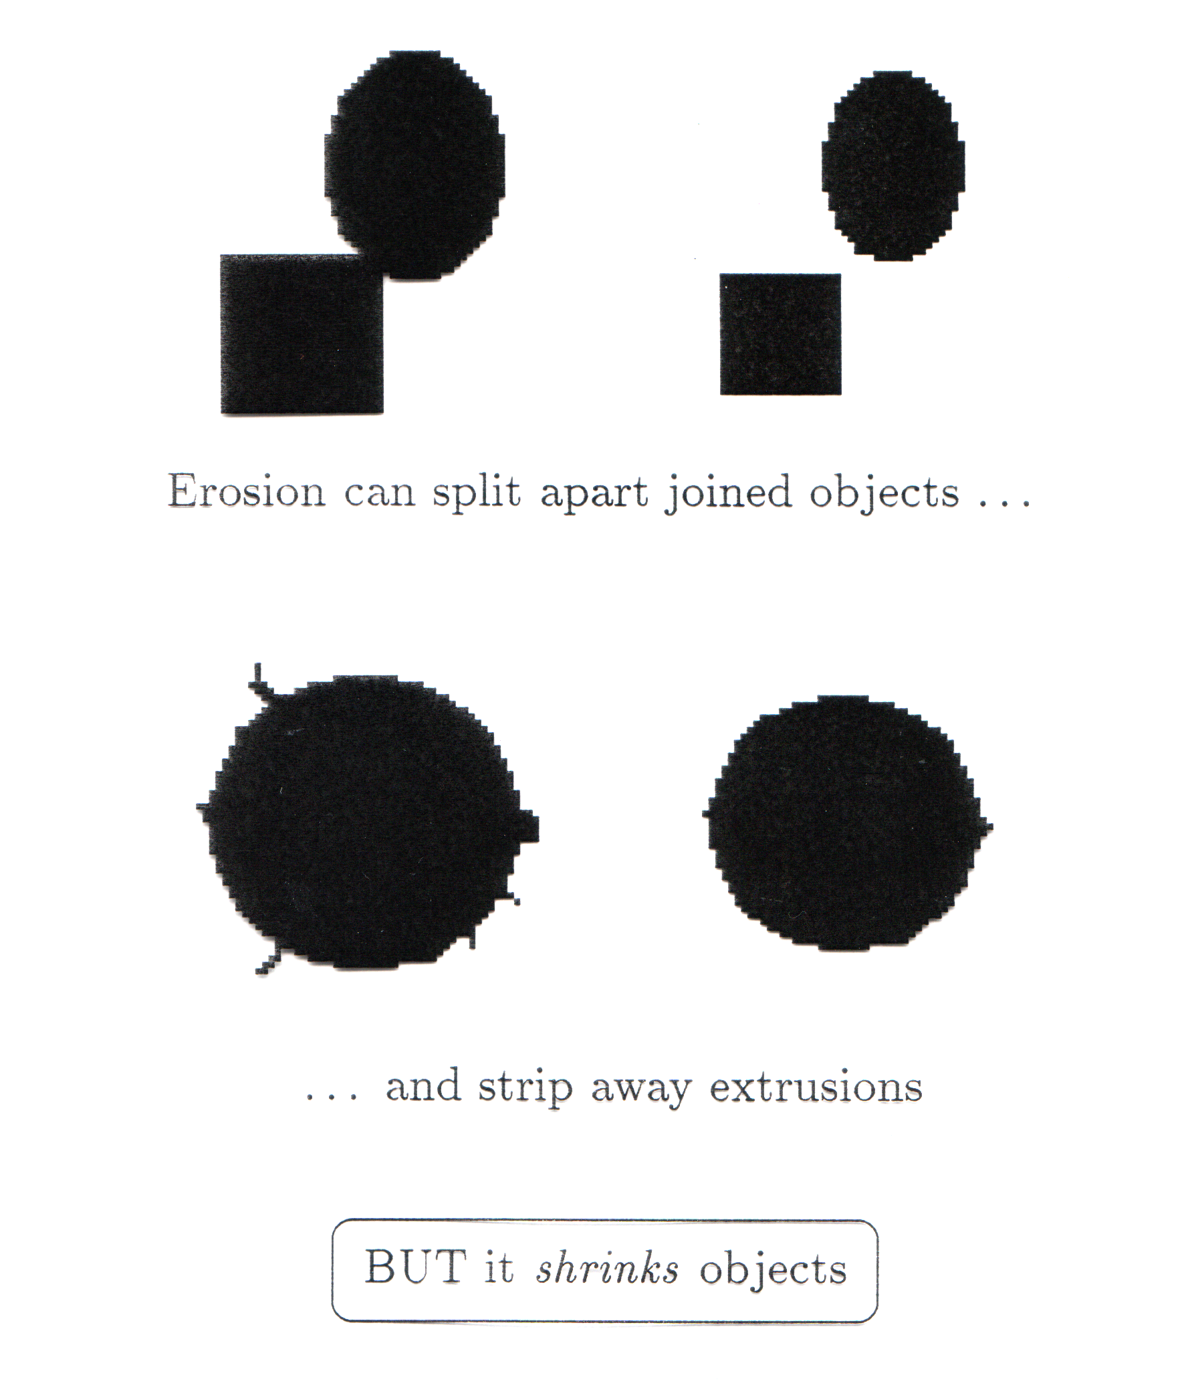
What Is Erosion For?
Erosion shrinks the connected sets of 1s of a binary image.
It can be used for
1. shrinking features
2. Removing bridges, branches and small protrusions
Watch out: Erosion shrinks objects
Erosion can split apart

Slide 15
Dilation (based on “Hit”)
Dilation of image f by structuring element s is given by f s
The structuring element s is positioned with its origin at (x, y) and the new pixel value is determined using the rule:

Slide 16
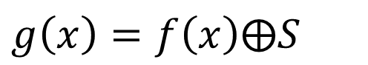
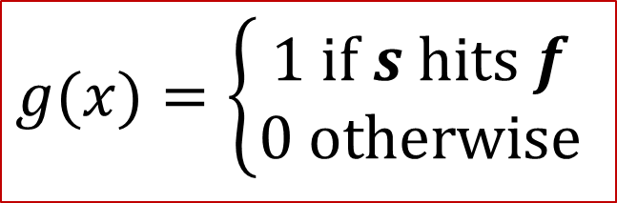
1D Dilation (based on “Hit”)
Input image
1 | 0 | 0 | 0 | 1 | 1 | 1 | 0 | 1 | 1
1
1
1
Structuring Element
Output Image
1
0
1
1
1
1
1
1
$$g(x)=\left\{\begin{matrix}\text{1 }\text{if} s \text{hits} f \\ \text{0 }\text{otherwise}\end{matrix}\right.$$
$$g\left(x\right)=f\left(x\right)⨁S$$

Slide 17
2D Dilation (based on “Hit”)
Original Image
Processed Image
Structuring Element

Slide 18
2D Dilation (based on “Hit”)
Original Image
Processed Image With Dilated Pixels
Pixels have been added to the object in output which hit
Pixels have been remained in output which hit
Overall Object get bigger
Structuring Element

Slide 19
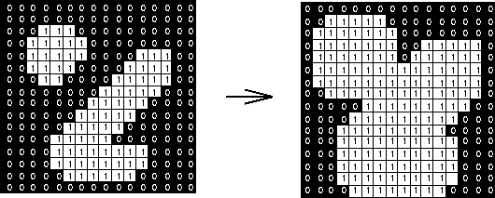
2D Dilation (based on “Hit”)
Structuring element
Objects are merged (holes are filled)
Sharp corners are preserved

Slide 20

Dilation Example 1
Original image
Dilation by 3*3 square structuring element
Dilation by 5*5 square structuring element
Watch out: In these examples a 1 refers to a black pixel!

Slide 21
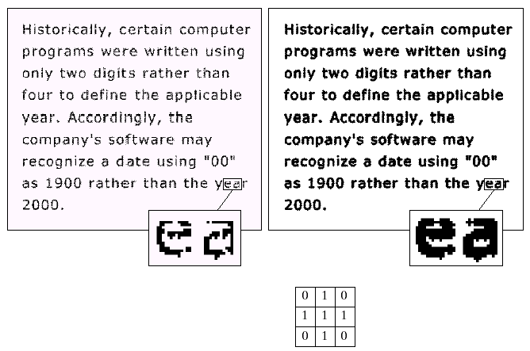

Dilation Example 2
Original image
After dilation
Images taken from Gonzalez & Woods, Digital Image Processing (2002)
Structuring element

Slide 22
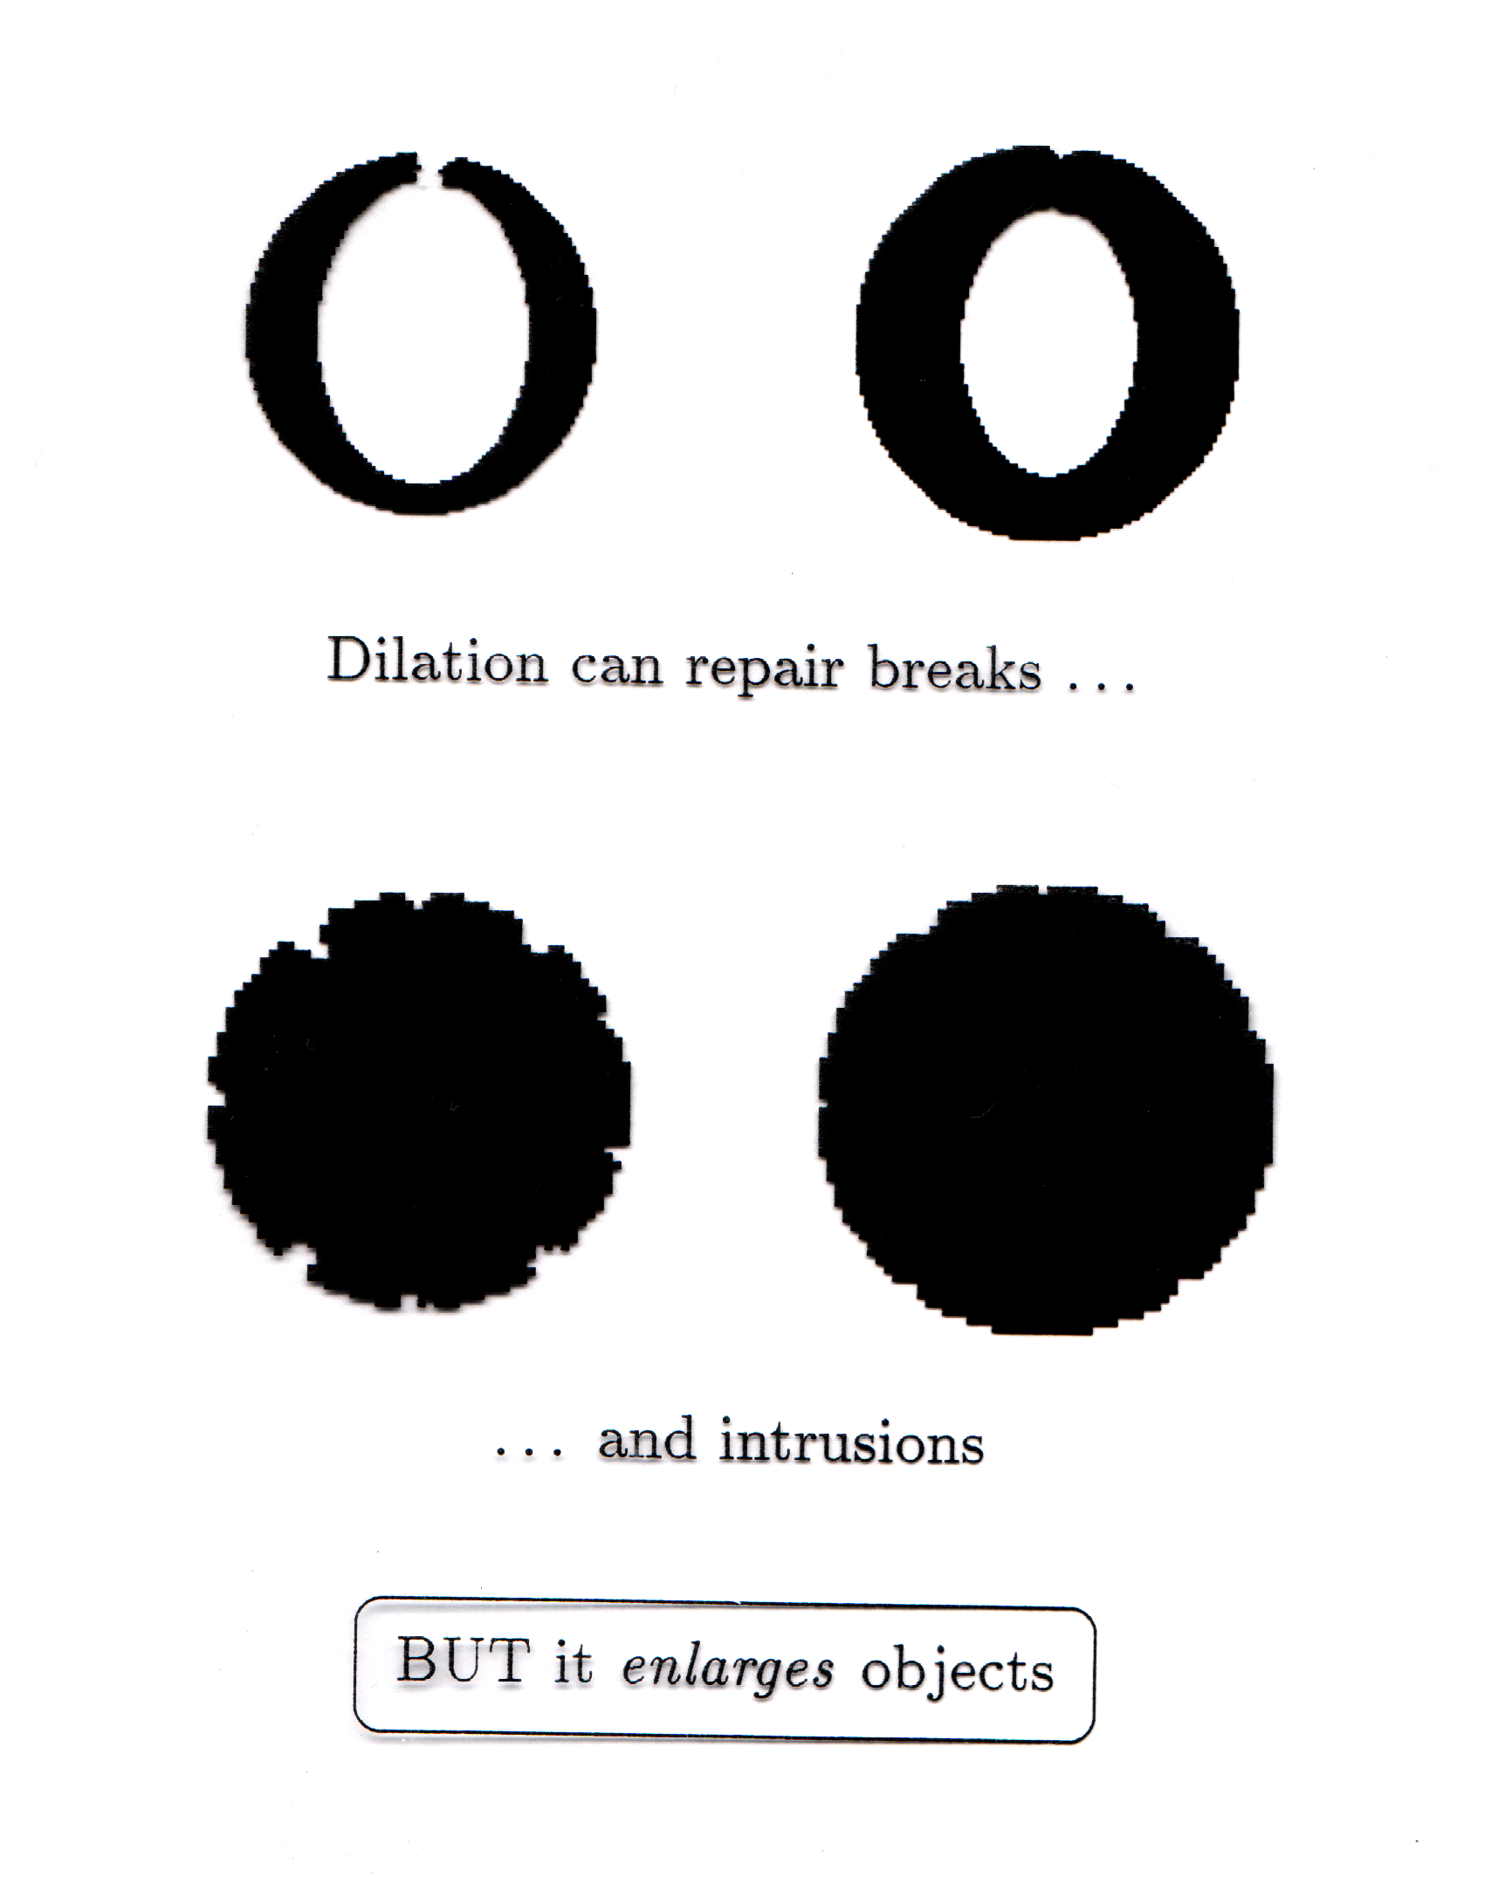
What Is Dilation For?
Dilation expands the connected sets of 1s of a binary image.
It can be used for
1. growing features
2. filling holes and gaps
Watch out: Dilation enlarges objects

Slide 23
Compound operations
Combining Erosion and Dilation into higher level (more advanced) operations
Finding the outline
Opening: Isolate objects and remove small objects (better than Erosion)
Closing: Fill holes (better than Dilation)
Others…

Slide 24
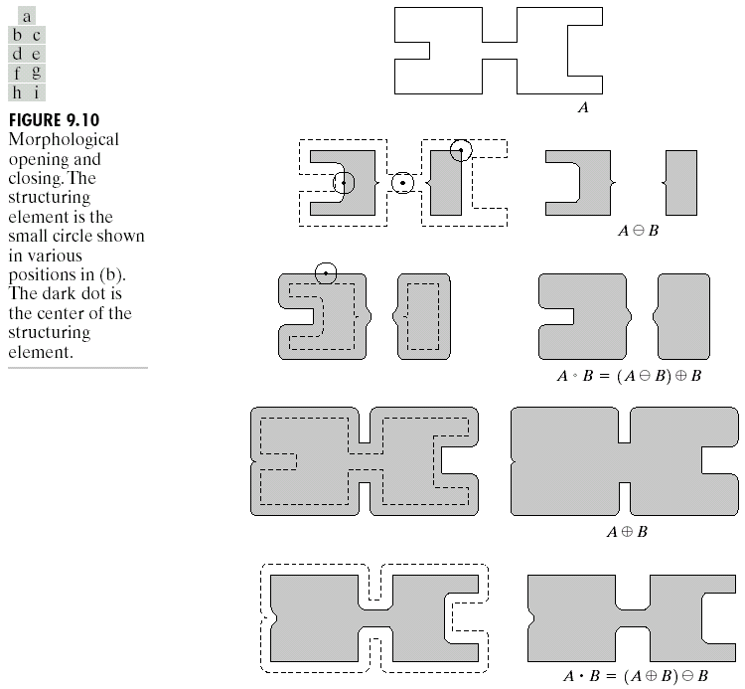
Opening
The opening of image f by structuring element s, denoted f ○ s is simply an erosion followed by a dilation
f ○ s = (f  s) s
Original shape
After erosion
After dilation (opening)
Note a disc shaped structuring element is used

Slide 25

Opening
Motivation: Remove small objects BUT keep original size (and shape)
Erosion + Dilation = Opening
Use the same structuring element!
Similar to erosion but less destructive
Opening is idempotent: Repeated operations has no further effects!
Original Image
Image After Opening

Slide 26

Opening
Structuring element:
Erosion
Dilation

Slide 27

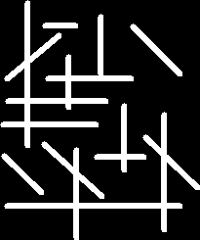

Opening Example
9x3 and 3x9 Structuring Elements
27

Slide 28
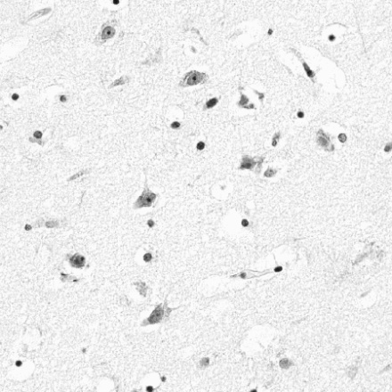
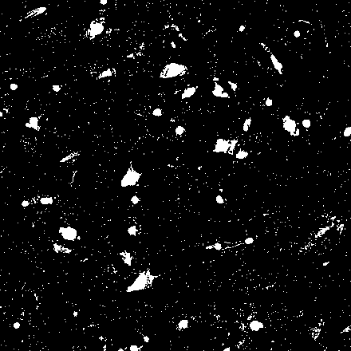
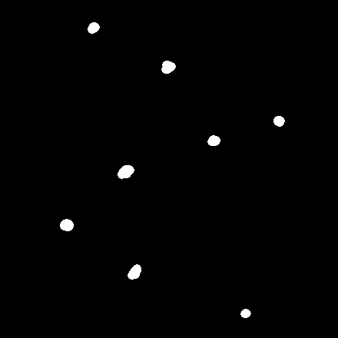
Opening Example
Use large structuring element that fits into the big objects
Structuring Element: 11-pixel disc
Original Image
After Thresholding
After Opening Operation

Slide 29
Closing
The closing of image f by structuring element s, denoted f s is simply a dilation followed by an erosion
f s = (f s)s
Original shape
After dilation
After erosion (closing)
Note a disc shaped structuring element is used

Slide 30
Closing
Original Image
Motivation: Fill holes BUT keep original size (and shape) Dilation + Erosion = Closing
Use the same structuring element
Similar to Dilation but less destructive
Closing is idempotent: Repeated operations has no further effects!
Image After Closing

Slide 31

Closing
Structuring element: 3x3 square

Slide 32


Closing Example
Closing operation with a 22-pixel disc
Closes small holes
32

Slide 33



Closing Example
Threshold
Improve segmentation
Closing with disc of size 20
Original Image
After Thresholding
After Closing Operation

Slide 34
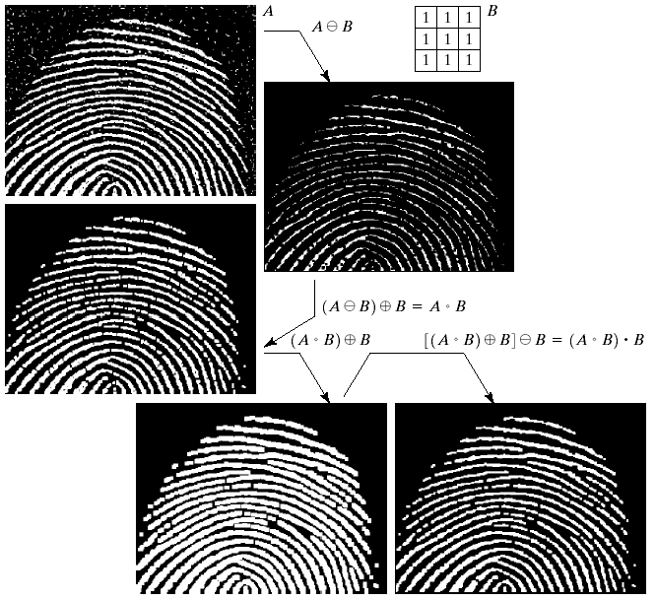
Morphological Processing Example

Slide 35
Thank You
For Your Attention

